Slide 1
ARE THE 5 K’S NECESSARY TODAY?
A son questions his father, and the father responds

Slide 2
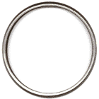

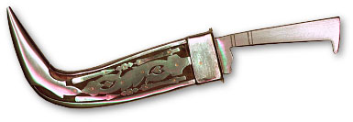
Sikh Articles of Faith
Five Articles of Faith
Mandatory for initiated Sikhs (called Khalsa) and encouraged for others.
1. Kesh - Uncut Hair
2. Kachha - Under-shorts
3. Kara - Bracelet, made of steel
4. Kanga - Comb, made of wood
5. Kirpan - Sacred Sword -- defensive
Kara
Kanga
Kirpan

Slide 3
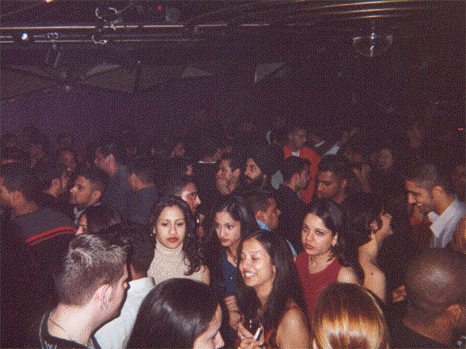


Jaskirat was from a fairly affluent family of Panjab and had been residing in a hostel for eleven years.
His friends did not consider him to be ‘hip’ (westernized) enough, and this was certainly a drawback.
Being ‘hip’ provided the key to the all-night parties and was a measure of the upward social mobility among the student community.

Slide 4
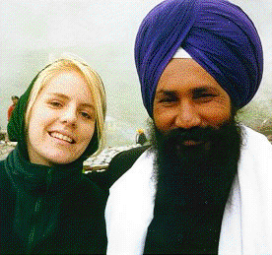
“Don’t you smoke?” was the usual query.
“Come on, you must be smoking in your room, all Sikhs do.
Go ahead, we are not going to write to your old man”.
Jaskirat’s flowing beard and his refusal to join his friends in drinking bouts and smoking joints of Marijuana earned him the nickname of “Sant Maharaj Ji.”

Slide 5
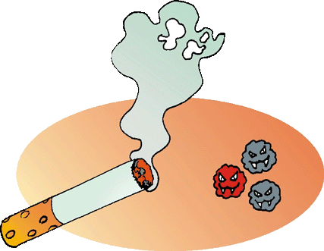
When Jaskirat told his friends that he did not smoke, they were not pleased with him and were not ready to take his word.
They called him a hypocrite behind his back.
But his ostracism on campus did not end there; the pressures were increasing every day.

Slide 6
For her it was a sign of cultural shallowness and crudeness of the mind.
Such behavior was certainly an obstacle in her endeavor to be one with the “in-Crowd.”
Amrita Kaur, a popular classmate and good friend of Jaskirats, was unwilling to accept his invitation to a party because he insisted on carrying a Kirpan with him.

Slide 7
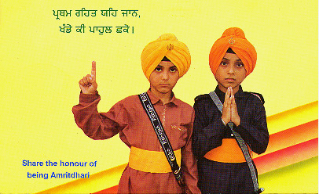
She was in no mood for a compromise this time and was determined to put him on the spot.
In her intellectual anger, she tersely told him,
“You claim to be progressive in your views, but you still carry a sword like a feudal hero.
If it is for self defense and honor, which you are so fond of claiming, then a machine gun would be more efficient to do the job.

Slide 8
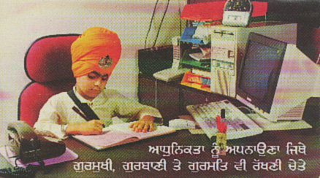
He was fortunate to have as his father a famous poet – who had been a guest lecturer at Cambridge, Harvard, and Michigan, and had spoken before various international associations and institutions.
Unable to carry on with the ever-increasing pressure of his tight rope walking, Jaskirat decided to write to his father, who was keen to see his son as a Guru ka Sikh.

Slide 9
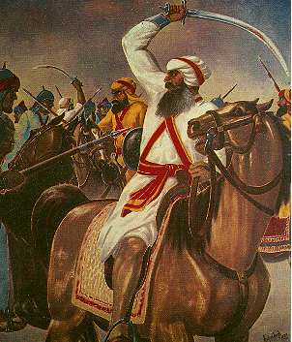
Letter of the son
My dear Dad, Sat Sri Akal.
It is with extreme pain, conflict, and misery that I resolved to write to you about my inability to accept the 5 K’s.
I have no question about the efficacy of these symbols three centuries ago.
They were essential in times of war to maintain the identity of Sikhs and give them a common denominator of unity.
It was a good strategy for fighting against an enemy bent on destroying the very seeds of Sikhism

Slide 10
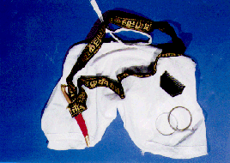
But for the present, these symbols have no justification, no meaning or any convincing explanation.
Sardar Partap Singh wrote a five-page article on the utility of the 5 K’s, but when I met him at the club last month, he was definitely not carrying a kirpan.
He is no exception in these double standards.

Slide 11
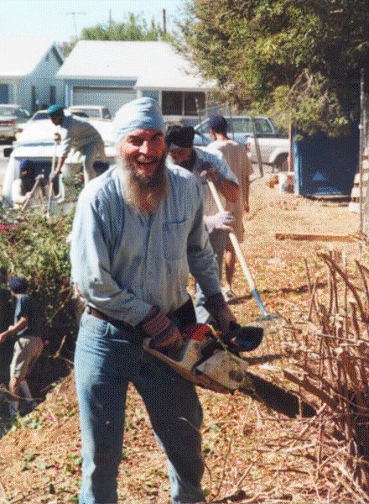
It is not me alone who has felt this lacuna, but most Sikh boys in my college are also unable to accept these symbols and their validity for everyday life.
They can establish no coherent connection between a kirpan and the human effort for the communion with God.
In no way can I convince them that these symbols make me more of a Sikh than them.
They are recognized as much Sikh as I am.

Slide 12
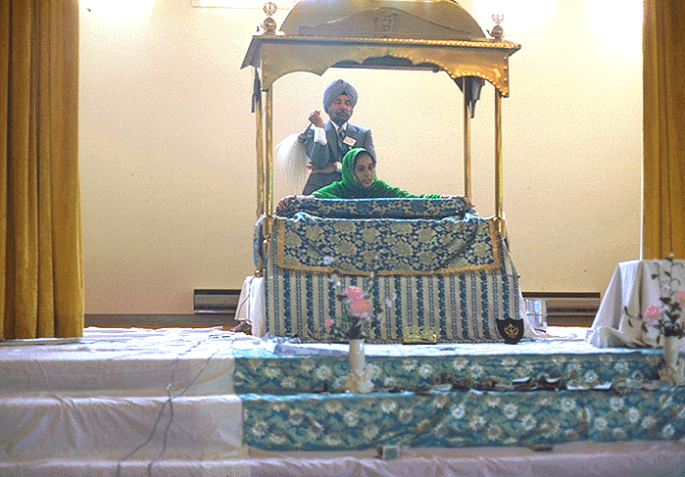
In fact more so because they are seen in tune with the modern times I as an idiot who sees in a set of 5 symbols a stepping stone for my liberation in the future.
A happy life and the 5 symbols seems to me to be an absurd and illogical equation.
The belief in God, the harm in smoking, the ill effects of drinking, the daily reading of the Japji - all these I have no objections to accept; but the 5 symbols do not fit into any logical framework.

Slide 13
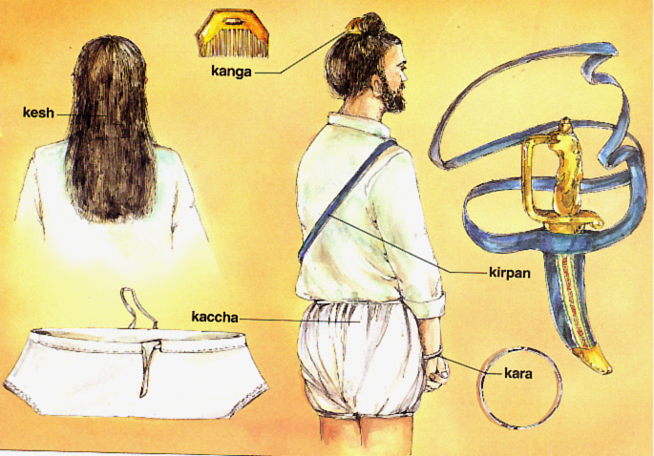
. As beliefs shape experience, these symbols become an inescapable reality.
Once the mind has experienced the pleasure, which identification through these symbols brings, the mind is firmly entrenched in this deceptive pleasure and nothing can shake it.
The end result is that we are slaves of this false identification.
  We do not want to question them because that would not be honorable.

Slide 14
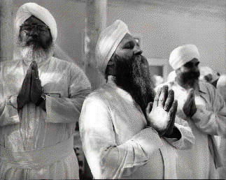
The acceptance of these symbols with them has become the means for gaining status in society.
But Dad, there must be freedom to grasp our own instincts and act accordingly.
And the older generation does not want us to inquire; they do not have the courage to face our questions.

Slide 15
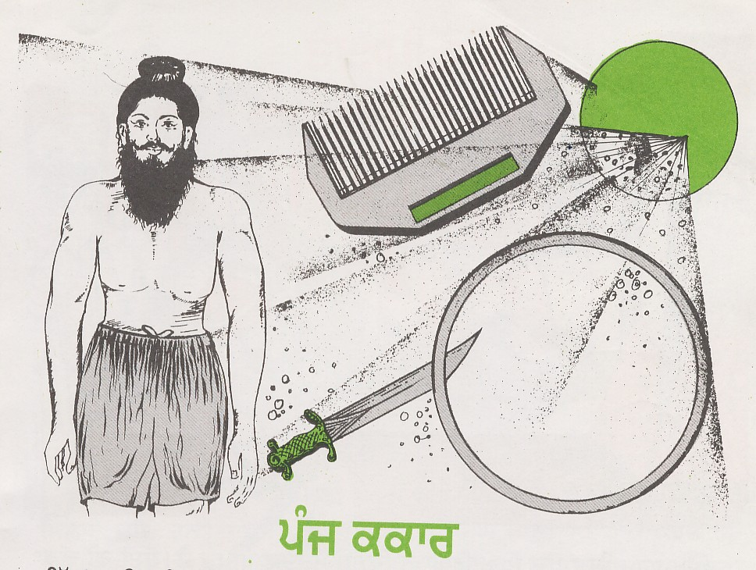
Why can’t I free myself from this structure of imitation?
It is constantly building up fear in me and this fear is further strengthening this structure.
To be my own self, I must break these imposed symbols.

Slide 16
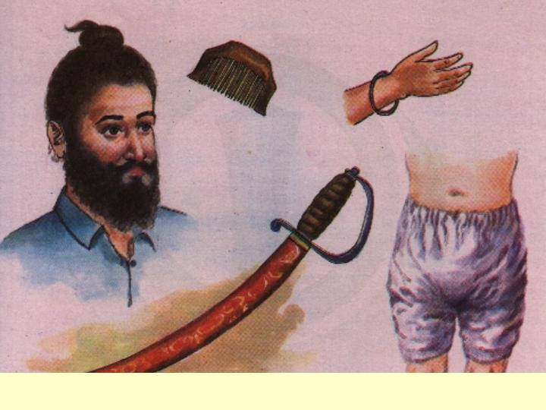
My belief in God is not bound to my hair.
These symbols are not religion, they are only the result of our being forced to conform to war conditions.
Is not religion something, much purer, and much deeper than these symbols?
We must learn to live without these symbols and face reality.
These signs have to be discarded and life has to be seen as it is.

Slide 17
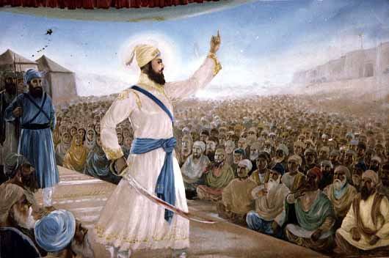
We are told that cultural, military, psychological, social, political, economic, spiritual, physical, and sexual factors were the main considerations, which made Guru Gobind Singh endow the Sikhs with the 5 K’s.
If I accept one set of these explanations, the next set contradicts the former. The explanations for the 5 K’s are a paradise of pick and choose.

Slide 18
One may choose the one, which fancies an individual the most, very much like a nice trouser in a show window.
It is not strange if some think that the choice is still not wide enough to appeal to their senses.
So they come out with the choice of discarding these symbols.

Slide 19
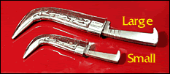
If I take the view that the Kirpan is for self-defense, can I discard it if I have twenty bodyguards with all the latest equipment for my protection?
Similarly, I can question the necessity of the other K’s.
Daddy, I am utterly incapable of understanding the value, the justification and the imposition of these symbols.

Slide 20
I am prepared to take the challenge and I give you my word that in case you can show me the way and the significance of these symbols, I will enjoy living the life of an Amrit-dhari Sikh.
Your loving son, Jaskirat

Slide 21
Reply from the father.
It is a pleasure to hear it all, so plainly stated.
I understand your feelings and I hope to be able to calm your mental anguish.
When you leave the university and face the world it seems to me that what is crucial in life is not to succumb to various pressures, but to understand and feel them as they are.

Slide 22
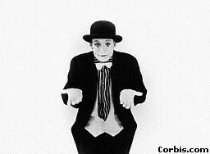
Do you see what I’m trying to tell you here?
You may question what is given to you or what many of your age assert, is being forced upon you – but this also means that you must question yourself.
It is only with such an integrated total approach, that you will understand not only the Kakaars, but also appreciate the agonies, the joys, the pain, the pleasure, the vanities and the hope of living.

Slide 23
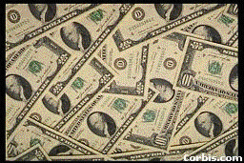
Materialistic world
Over and over again, you want to know the significance of the 5 K’s?
In our efforts to be practical individuals, we want to imbibe only what is of utility and significance, the rest we want to discard.
The search for significance in everything is a curse of the present century.

Slide 24
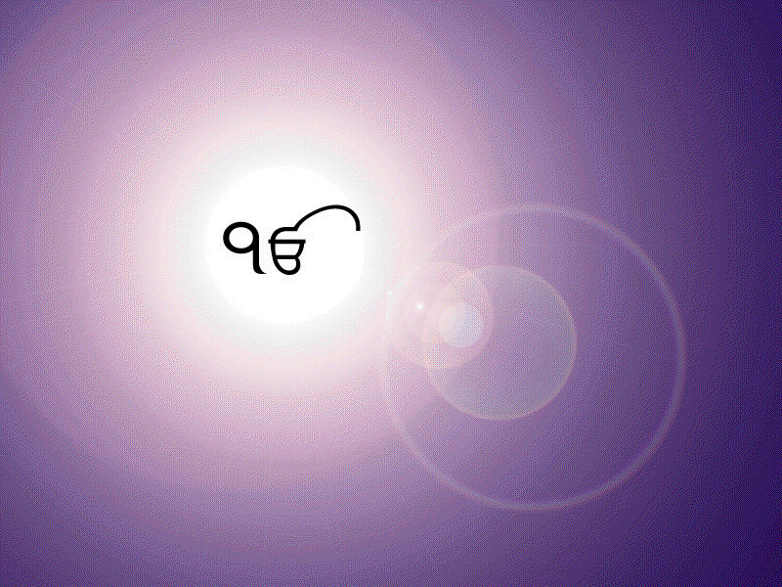
Keep in mind that we live in a…
Materialistic world & Spiritual World
  It is a form of self-killing and therefore it breeds the fear of living.
The whole world, all your friends, your relations, everyone is struggling for significant and useful things.

Slide 25
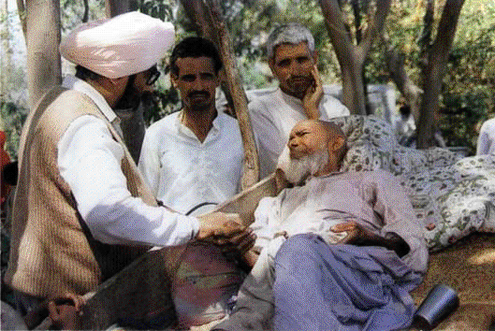
But what might be significant for you, might not be so for your friends.
If you go to a man who has ill health, he will undoubtedly say, what is significant is good health.
If you go to a mother, she will say the significant thing is to have a son.
This is the reason you find an intricate web of explanations, for the significance of the 5 K’s.

Slide 26
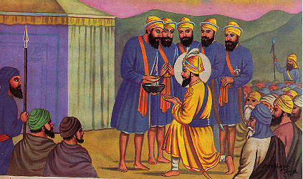
Get free of this yoke of significance
The first step in your questioning of the 5 K’s should be to get free of this yoke of significance
. It is this illusionary search for significance, which has made many youth and their seniors to discard their articles of faith.
They see no value in them
It is a pity that we went to reduce Sahib Guru Gobind Singh Ji, to our own mundane level of thinking and view all his actions in light of practical utility

Slide 27
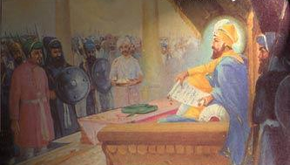
If he was in search of merely objects of practical utility, he could have made a truce with Aurangzeb, when the latter made the offer.
Notes:
At last came an autographed letter from the Emperor to the Guru- "I have sworn on the Quran not to harm. You. If I do, may I not find a place in God's court hereafter! Cease warfare and come to me. If you do notdesire to come hither, then go whithersoever you please." The Emperor's envoy added that the Emperor promised that he would not harm the Guru. The hill Rajas also swore by the cow and called their idols to witness, that they would allow safe passage to the Guru.

Slide 28
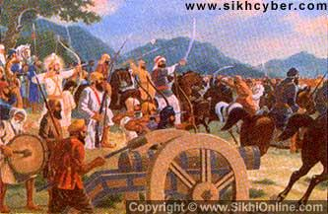
But he was not inspired out of a hunt for weapons of self-defense or practical value, as we would make it out, reflecting reflecting our own thinking backwards in history.
The sword, anyway, in the battlefield would have been useless without a shield.
If the Guru wanted the 5 K’s to be reflections of practical use values, he could have very well added not only more weapons, but instead of a sword, he could have given us a gun, as guns did exist at that time.

Slide 29
Proud to wear the brand name of Guru Gobind Singh.
A Briton was asked, “Why do you wear a turban?
Is it not enough for you to practice the philosophy of Guru Gobind Singh in your social and personal life?”
He replied, The people accept me as the son of Guru Gobind Singh.
Is it not enough reason to wear the turban?”
“

Slide 30
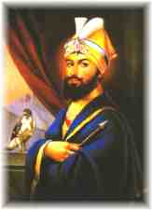
Proud to wear the brand name of Guru Gobind Singh.
This can be understood when we see many people, particularly the youth, having clothes and shoes bearing brand names.
The Sikhs are similarly proud to wear the brand name of Guru Gobind Singh.

Slide 31
Gifts from Guru
The Kanga, the Kesh, the Kara, the Kirpan, the Kachha, were all delicate gifts of love and beauty to the Khalsa from a man who desired nothing for himself, but everything for the Khalsa

Slide 32
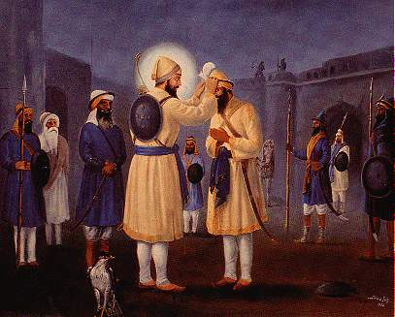
“If thou art zealous of playing the game of love, then enter upon my path with thy head on thy palm.”
It was out of such love that these gifts were presented to the Khalsa and not out of any attempts to carve out soldiers
These gifts were from a Guru who totally surrendered everything for the cause and unique love of the Khalsa.

Slide 33
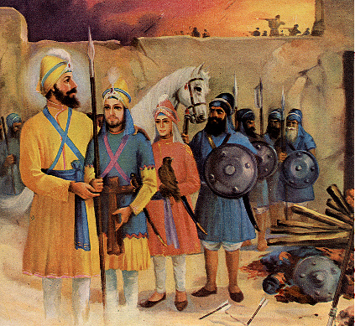
No love without total commitment
When there is total love, there is action, there is sacrifice, is there not?
The love of the Guru for the Khalsa was not the result of mental vibrations.
In his life, there was no gap between love and action, as there is between our thinking and action.
Sending sahibzadas for
Battle at chamkaur

Slide 34


No love without total commitment
.
It is only we who want to be one sided in our love and make claims of loving the Guru in our ideals.
Consequently we reason out that we don’t have to express our love for Him in action, in the Kesh.
But can there be love without total commitment and action? No.

Slide 35
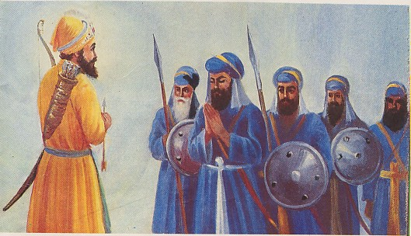
Love of the Guru for the Khalsa in sarabloh Granth
The total love of the Guru for the Khalsa becomes apparent in the book titled the Sarbloh, where, He becomes one with the Khalsa and portrays the Khalsa as his highest love:
Khalsa is the breath of my body,
Khalsa is the very soul of my life.
Khalsa is my object of meditation.
Khalsa gives me intellect and wisdom,

Slide 36
Beauty of the gifts
The mind that lives the Sikh way of life can know what is the beauty of the gifts the Guru gave to us.
The 5 ornaments that we wear are the gifts, from the Guru whose whole family was sacrificed for the total love of the Khalsa.
Could such a Guru be looking for practical utilities of an animal existence?
He was not the person to endow us with gifts of mere practical value, but gifts of love, which knew no questioning, no bartering, no deals, and no betraying.

Slide 37
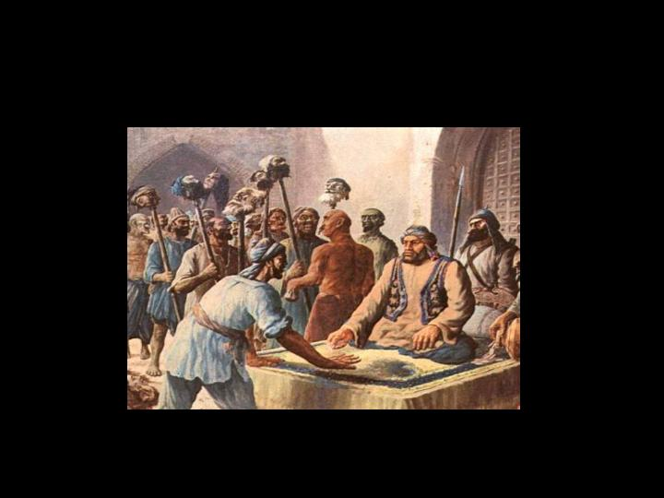
His was a total sacrifice and a total love, in both thought and action, for the happiness of the Khalsa.
These gifts had their pangs of birth in a sea of human blood.
It was not out of any practical benefit that the evil genius of the Mughal government announced awards for the hair of the Sikhs.
It was because they knew that, the Khalsa, deprived of these gifts (the Guru’s love), would disintegrate.
Mughal government announced awards for the hair of the Sikhs

Slide 38
The Kirpan is a gift from Guru Gobind Singh Ji to the Khalsa.
It is not to be judged and measured as a weapon of war or peace, it is a gift activated by the love of the Guru.
Even a whole army of bodyguards or the best police state in the world cannot make it redundant.
It shall always remain attached to me. The sword is the love wherein the Guru resides.
Kirpan is a gift from Guru Gobind Singh Ji

Slide 39
Our superficial hollow life is no way less discouraging.
The day to day fragmentary living, the everyday struggle for food, the daily pain, suffering, distress, torments, and headaches are in no way less discomforting.
But in spite of all this, do we cease to exist?
You say it is inconvenient, frustrating, and impractical to grow our hair long.
But more frustrating is an existence of no inspiration and no effort

Slide 40
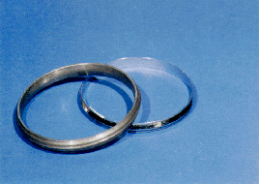
The Kara has to be received by us as a present with the message, “Guru loves me. He made me His own.”
You want to question the utility of the iron bangle of the Guru, but not of the gold bangle which is so much in vogue at Sikh engagement ceremonies today.
You are ready to discard the Guru’s bangle for the yellow metal.
Kara --“Guru loves me. He made me His own.”

Slide 41
Kara comes to us as a manifestation of His love and benediction.
From the day we put it on our wrists, the Kara was forever ours; no one could separate it from a Sikh.
And we still want to find reasons for wearing it.

Slide 42
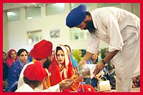
wedding gifts
Do not make our presents into dead symbols, they are the gorgeous ornaments of the living.
We are the “Wedded devotees” of God.
They are the wedding gifts from our Bridegroom.
He gave all of them to us and they are God-sent, imperishable, indispensable, and indestructible.

Slide 43
You may object and say all this is irrational, unacceptable, superstitious, and fatalistic.
But the waves of pure love always have their own logic, irrationality and fatalism.
I love the Guru’s irrationality- if you want to call it so. “To serve them pleases me.”
I don’t have the courage to reject such devotion.

Slide 44
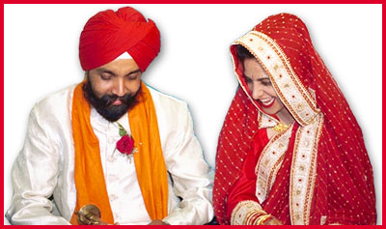
Does a would-be-wife question the intrinsic value of the engagement ring, she is gifted by her husband?
No, never, even if it is made of copper or a shell.

Slide 45
Today, you want to discard these gifts, because gold has more value.
The choice is yours, the consequences are yours.
The bliss of love is yours, the solitude of separation is yours.
These gifts are not to be stored in the darkness of the cellars; drink deep into them, if you want to live in spiritual grandeur.

Slide 46
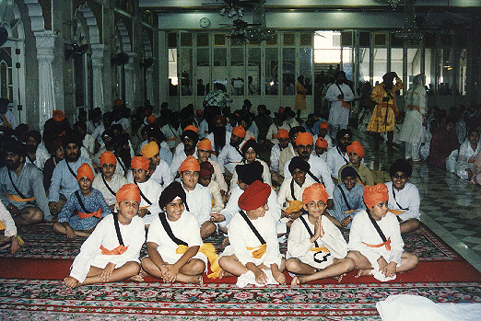
The head of a Sikh, (the Kesh of a Singh) having been once offered to and accepted by the Guru, is in unceasing trust with Him.
It is, therefore, imperative for a Sikh to carry his head high and not to bow it before a mortal barber.
I shall only bend and bow before the Guru.
The head of a Sikh, (the Kesh of a Singh) having been once offered to and accepted by the Guru, is in unceasing trust with Him

Slide 47
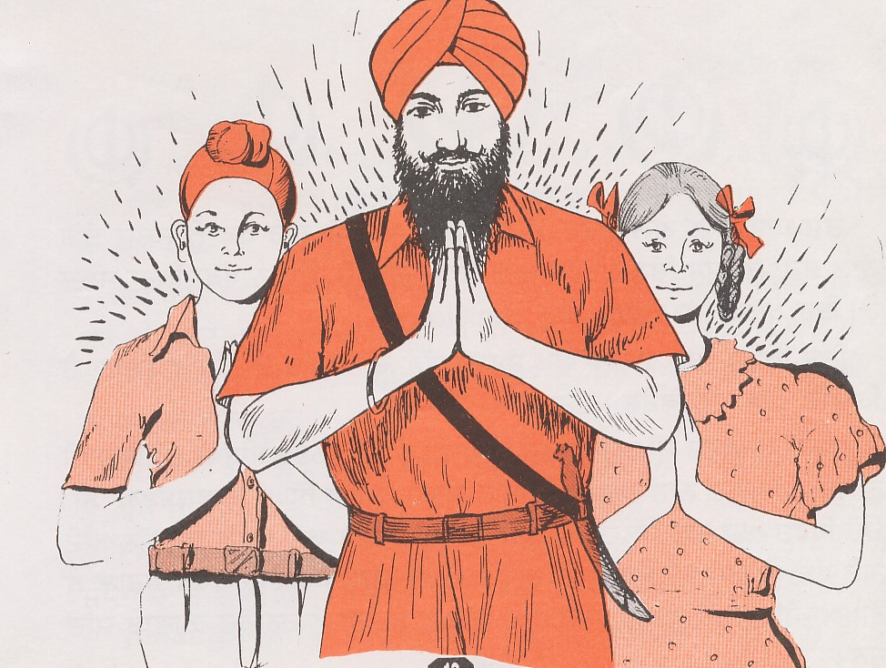
Every day we recite in our prayer “Nanak das sada kurbani.” “Nanak thy servant is ever a sacrifice to Thee.”
But instead we sacrifice our 5 K’s.
Shocking is our spirit of sacrifice.
Are we the worthy inheritors of this heritage?
After drawing on his blood, now by discarding our 5 K’s, we want to stab him in the back!

Slide 48
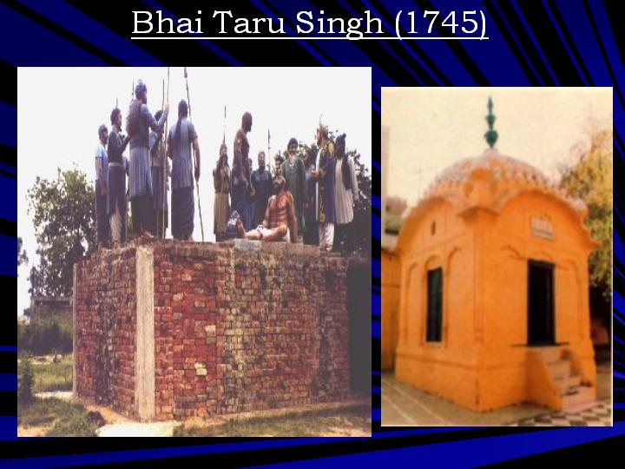
one kilometer from the Lahore railway station stands a gurdwara, sacred to the Sikhs in the loving memory of Bhai Taru Singh Ji.
It bears the name of Shahid Ganj, the Abode of Martyrs.
The governor said to him, “Somehow my heart does not permit me to have you killed, but you must cut and present me your tress-knot.”
Shahid Ganj, the Abode of Martyrs

Slide 49
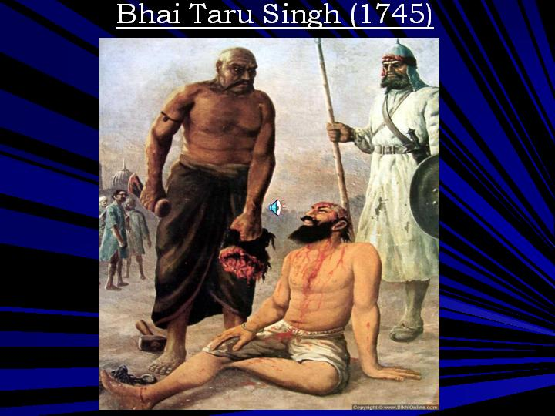
Taru Singh replied, “The Sikh and his hair are one. I will be pleased to give you more than you ask me, my head with my tress-knot. These hair are the eternal gift of love, they cannot be separated from a Singh’s head without separating his head.”
Hearing the offer of a high office and an estate for his tress-knot, the Singh continued, “Neither my life, nor my hair are for bargaining in your court which views beauty, life, and religion in weights of gold.
.”
The value and beauty of our hair cannot be measured in terms of luxuries and jagirs

Slide 50
Thakur Rabindranth Tagore, a Nobel laureate, has beautifully sung of this episode: “More than asked for.”
if Bhai Taru Singh had looked for practical utility, significance and relevance, wouldn’t he have exchanged his hair for a jagir, for beautiful women, and the power he was offered?
But all these he regarded as worthless when he weighed them with his way of life.
If the hair were mere symbols for him, would he have staked his life for them.

Slide 51

Love is not to be hooked in the net of intelligence; if you use knowledge to grasp love, it will die as a fish does out of water.

Slide 52
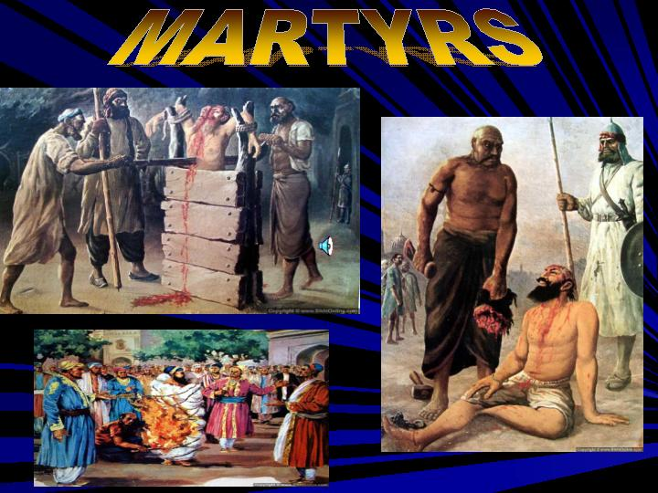
We find not only Bhai Taru Singh, but a whole galaxy of martyrs in our History, all playing with their lives, which appears to us so irrational and fatalistic.

Slide 53
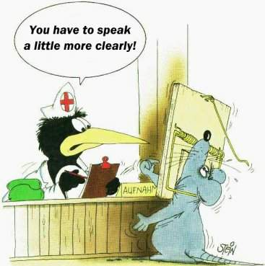
Knowledge is like a kerosene lamp on a dark night, it can illuminate only so long as it has fuel.
Life is much vaster and deeper, it cannot be lived with the aid of an extinguishable lamp.
Knowledge is essential to everyday existence, as money is to buy your food, but it cannot grasp the reality of love, of God, of living.

Slide 54
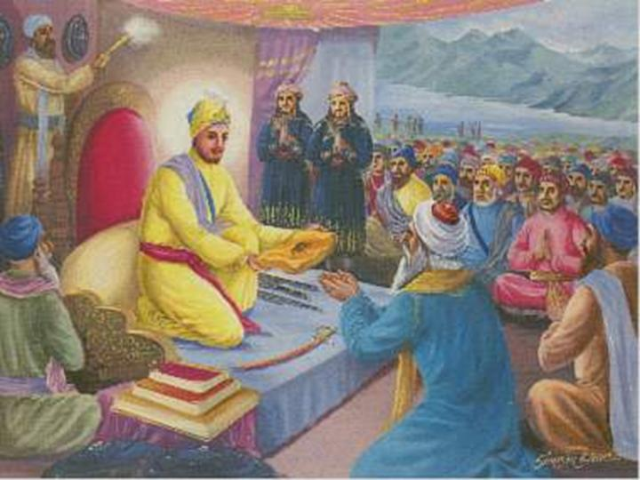
After the victory of the battle of Bhangani, Guru Gobind Singh Ji blessed Pir Budhu Shah with no treasures and no elephants for his services, as was the custom of that time.
However, the Guru gave him the gift of a kirpan and a comb with some broken hair of his.
This very ‘jewelry’, he presented to all of us, in spite of the fact that our lives were not wrought in the furnace of sacrifice; a jewelry which no craftsman, no intellectual, no jeweler is capable of imitating.
PIR Budhu shah
asked for hair and
not treasures after
Sacrificing sons in
the battle of Bhangani

Slide 55
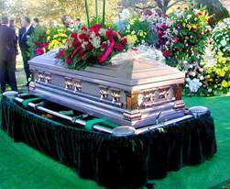
living monument
ask not from me, the significance and the value of our tress-knots, for I am incapable of describing it.
In our mystical tress-knots, insipid mankind is inspired.
People build monuments for the dead, you want to uproot the living monument the Guru gave to you.
If you want it to disintegrate you may, but you shall forever be buried under it.

Slide 56
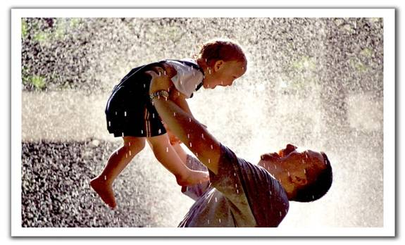
Beauty and the love can never be dissected
The beauty and the love can never be dissected and summed up.
What would the cuckoo’s song mean to you, if you want to take down its notations and analyze them?
What would your mother’s love be for you if you want to know her by analysis

Slide 57
His gifts of love
In the end, let me conclude that the Kesh, the Kachha, the Kara, the Kanga, the Kirpan, are the gifts, chiseled out for the Khalsa by the Divine Artist.
These are the gifts endowed to us forever, by the Divine Bridegroom, on the day of our ‘marriage’ to Him on Baisakhi in 1699.
We will carry His gifts of love, in honor, purity, and splendors.
Our love will blossom in all climes, in all times and in all continents.

